Slide 1


History and Current Challenges in the field of Robotics
Christian Siagian
(adapted from lectures by Dr. Maja Mataric &
Dr. Gaurav Sukhatme)
Univ. Southern California, CA, USA

Slide 2
Outline
Definition of a robot
History of robotics
Sub-field in Robotics

Slide 3
Defining “robot”
What makes a robot
Sensors, sensor space
State, state space
Action/behavior, effectors, action space
The spectrum of control

Slide 4
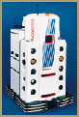
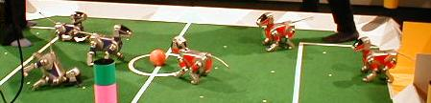
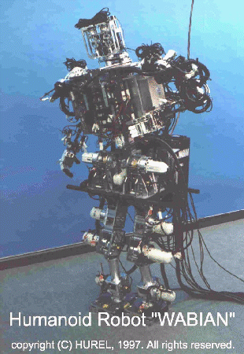
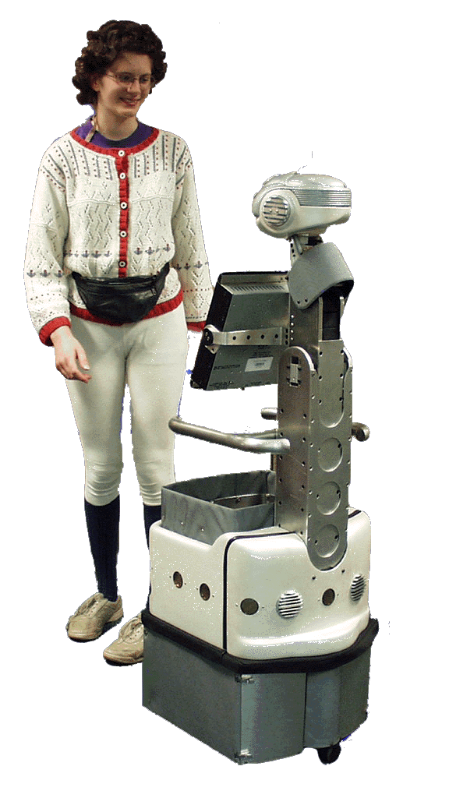
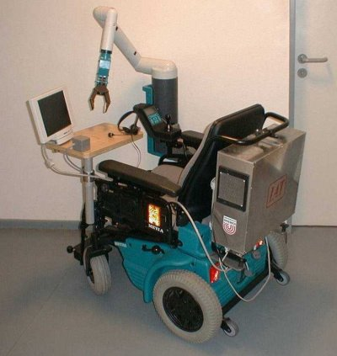
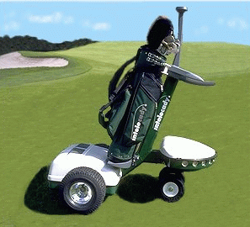
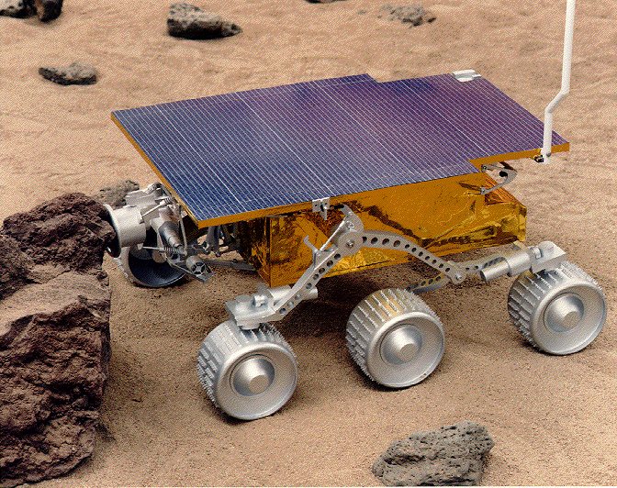
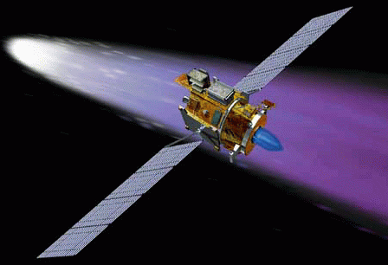
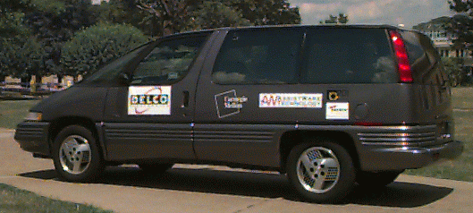
Robots Today

Slide 5
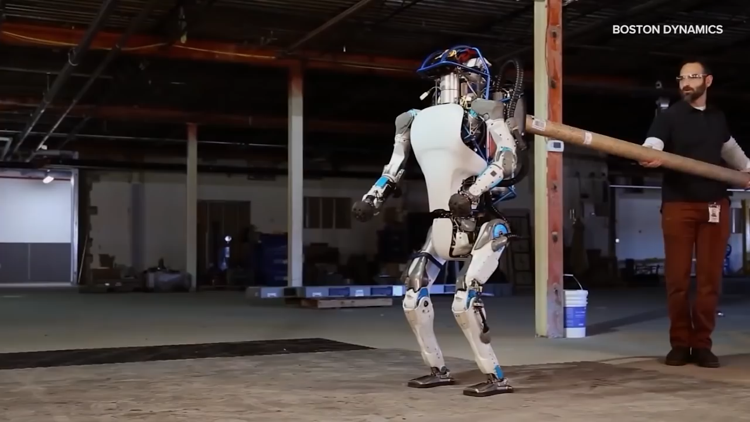
Robots Today: Anthropomorphic

Slide 6
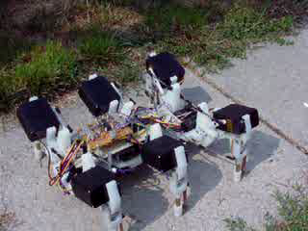
Robots today: Animal-like robots

Slide 7
Why “robot”?
The term “robot” comes from Karel Capek’s 1921 play RUR (Rossum’s Universal Robots)
“robotics” first introduced by Isaac Asimov in his science fiction writing
It is most likely a combination of “rabota” (obligatory work) and “robotnik” (serf).
The kind of robotics we will talk about will move far beyond such “obligatory work.”

Slide 8
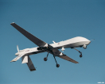
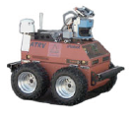
Alternative terms
UAV: Unmanned Aerial Vehicle
UGV: Unmanned Ground Vehicle
UUV: Unmanned Undersea (underwater) Vehicle
AUV: Autonomous Underwater Vehicle

Slide 9
What is a Robot?
A robot is a system which exists in the physical world and autonomously senses its environment and acts in it to achieve some goals.

Slide 10
Other Definitions
A robot is a re-programmable, multi-functional, manipulator designed to move material, parts, or specialized devices though variable programmed motions for the performance of a task (Robotics Industry Association)
Robotics is the intelligent connection of perception to action (M. Brady)
Notes:
Maybe put pictures or videos

Slide 11
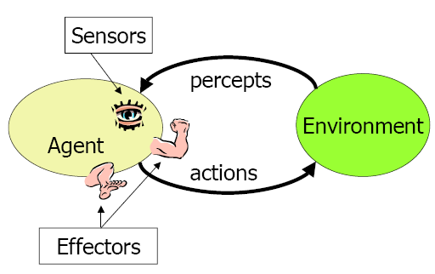
What Makes a Robot?
A robot consists of:
sensors
effectors/actuators
(communication)
controller
A robot is capable of:
acting autonomously
achieving goals

Slide 12
Sensors: what can be sensed?
Depends on the sensors on the robot
The robot exists in its sensor space: all possible values of sensory readings
Also called perceptual space
Robot sensors are very different from biological ones
A roboticist has to try to imagine the world in the robot’s sensor space

Slide 13
State: what can be known?
A sufficient description of the system
can be:
Observable: robot always knows its state
Hidden/inaccessible/unobservable: robot never knows its state
Partially observable: the robot knows a part of its state
Discrete (e.g., up, down, blue, red)
Continuous (e.g., 3.765 mph)

Slide 14
Types of State
External state: state of the world
Sensed using the robot’s sensors
E.g.: night, day, at-home, sleeping, sunny
Internal state: state of the robot
Sensed using internal sensors
Stored/remembered
E.g.: velocity, mood
The robot’s state is a combination of its external and internal state.

Slide 15
State and Intelligence
State space: all possible states the system can be in
A challenge: sensors do not provide state!
How intelligent a robot appears is strongly dependent on how much it can sense about its environment and about itself.

Slide 16
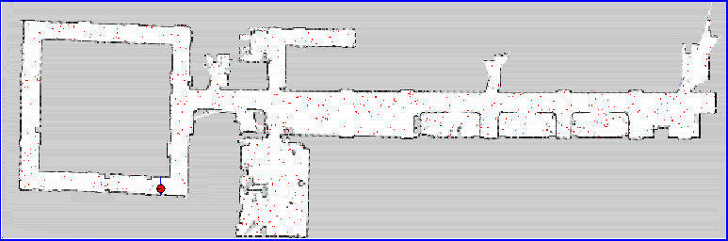
Internal Models
Internal state can be used to remember information about the world (e.g., remember paths to the goal, remember maps, remember friends v. enemies, etc.)
This is called a representation or an internal model.
Representations/models have a lot to do with how complex a controller is!

Slide 17
Action/Actuation
A robot acts through its actuators (e.g., motors), which typically drive effectors (e.g., wheels)
Robotic actuators are very different from biological ones, both are used for:
locomotion (moving around, going places)
manipulation (handling objects)
This divides robotics into two areas
mobile robotics
manipulator robotics

Slide 18
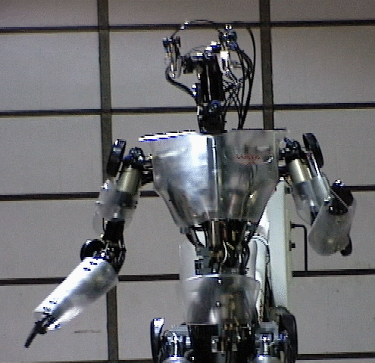
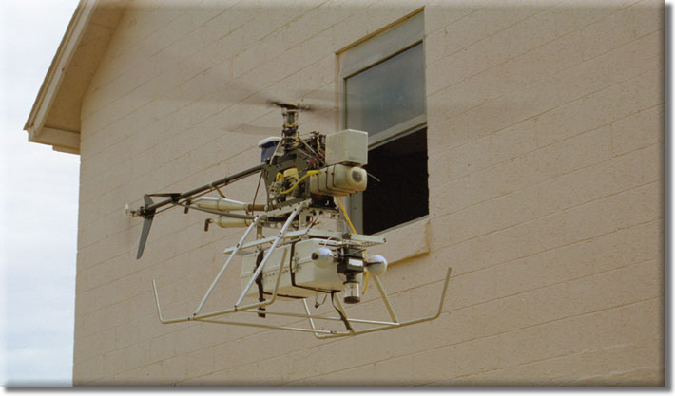
Actuators and DOF
Mobile robots move around using wheels, tracks, or legs
Mobile robots typically move in 2D (but note that swimming and flying is 3D)
Manipulators are various robot arms
They can move from 1 to many D
Think of the dimensions as the robot’s degrees of freedom (DOF)

Slide 19
Action vs. Behavior
Behavior is what an external observer sees a robot doing.
Robots are programmed to display desired behavior.
Behavior is a result of a sequence of robot actions.
Observing behavior may not tell us much about the internal control of a robot. Control can be a black box.
black box

Slide 20
Autonomy
Autonomy is the ability to make one’s own decisions and act on them.
For robots, autonomy means the ability to sense and act on a given situation appropriately.
Autonomy can be:
complete (e.g., R2D2)
partial (e.g., tele-operated robots)

Slide 21
Control
Robot control refers to the way in which the sensing and action of a robot are coordinated.
The many different ways in which robots can be controlled all fall along a well-defined spectrum of control.

Slide 22
A brief history of robotics
Feedback control
Cybernetics
Artificial Intelligence (AI)
Early robotics
Robotics today
Why is robotics hard?

Slide 23
Feedback Control
Feedback: continuous monitoring of the sensors and reacting to their changes.
Feedback control = self-regulation
Two kinds of feedback:
Positive
Negative
The basis of control theory

Slide 24
- and + Feedback
Negative feedback
acts to regulate the state/output of the system
e.g., if too high, turn down, if too low, turn up
thermostats, toilets, bodies, robots...
Positive feedback
acts to amplify the state/output of the system
e.g., the more there is, the more is added
lynch mobs, stock market, ant trails...

Slide 25
Uses of Feedback
Invention of feedback as the first simple robotics (does it work with our definition)?
The first example came from ancient Greek water systems (toilets)
Forgotten and re-invented in the Renaissance for ovens/furnaces
Really made a splash in Watt's steam engine

Slide 26
Cybernetics
Pioneered by Norbert Wiener (1940s)
(From Greek “steersman / governor” of steam engine)
Marriage of control theory (feedback control), information science and biology
Seeks principles common to animals and machines, especially for control and communication
Coupling an organism and its environment (situatedness)

Slide 27
W. Grey Walter’s Tortoise (1950’s)
Machina Speculatrix
1 photocell & 1 bump sensor, 1 motor
Behaviors:
seek light
head to weak light
back from bright light
turn and push
recharge battery
Reactive control

Slide 28

The Walter Turtle in Action

Slide 29
Braitenberg’s Vehicles
Valentino Braitenberg (early 1980s)
Extended Walter’s model in a series of thought experiments
Also based on analog circuits
Direct connections (excitatory or inhibitory) between light sensors and motors
Complex behaviors from very simple mechanisms

Slide 30
Braitenberg’s Vehicles
Examples of Vehicles:
V1:
V2:

Slide 31
Braitenberg’s Vehicles
By varying the connections and their strengths, numerous behaviors result, e.g.:
“fear/cowardice” - flees light
“aggression” - charges into light
“love” - following/hugging
many others, up to memory and learning!
Reactive control
Later implemented on real robots

Slide 32
Early Artificial Intelligence
“Born” in 1955 at Dartmouth
“Intelligent machine” would use internal models to search for solutions and then try them out (M. Minsky) => deliberative model!
Planning became the tradition
Explicit symbolic representations
Hierarchical system organization
Sequential execution

Slide 33
Artificial Intelligence (AI)
Early AI had a strong impact on early robotics
Focused on knowledge, internal models, and reasoning/planning
Basis of deliberative control in early robots

Slide 34
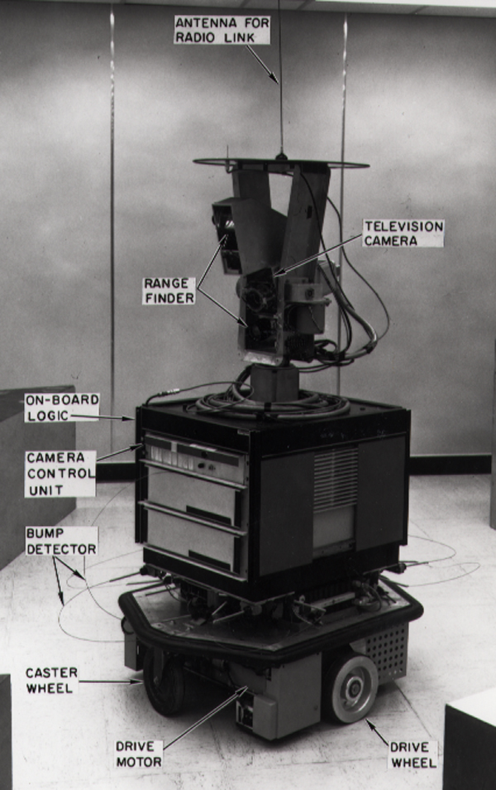
Early Robots: SHAKEY
At Stanford Research Institute (late 1960s)
Vision and contact sensors
STRIPS planner
Visual navigation in a special world
Deliberative
1972 model

Slide 35
Early Robots: HILARE
LAAS in Toulouse, France (late 1970s)
Video, ultrasound, laser range-finder
Still in use!
Multi-level spatial representations
Deliberative -> Hybrid Control

Slide 36
Early Robots: CART/Rover
Hans Moravec
Stanford Cart (1977) followed by CMU rover (1983)
Sonar and vision
Deliberative control

Slide 37
What’s the problem?
Robot is slow in deliberation
Based on the sense->plan->act (SPA) model
Inherently sequential
Planning requires search, which is slow
Search requires a world model
World models become outdated
Search and planning takes too long

Slide 38
Reactive Systems
Collections of sense-act (stimulus-response) rules
Inherently concurrent (parallel)
No/minimal state
No memory
Very fast and reactive
Unable to plan ahead
Unable to learn
Sentinel papers:
Brooks, R. A., Intelligence Without Reason
Brooks, R.A., A robust layered control system for a mobile robot.

Slide 39
Spectrum of Control

Slide 40
Hybrid Systems
Combine the two extremes
reactive system on the bottom
deliberative system on the top
connected by some intermediate layer
Often called 3-layer systems
Layers must operate concurrently
Different representations and time-scales between the layers
The best or worst of both worlds?

Slide 41
Behavior-Based Systems
An alternative to hybrid systems
Have the same capabilities
the ability to act reactively
the ability to act deliberatively
There is no intermediate layer
A unified, consistent representation is used in the whole system=> concurrent behaviors
That resolves issues of time-scale

Slide 42
So, are we done?
Sensors are limited and crude
Effectors are limited and crude
State (internal and external, but mostly external) is partially-observable
Environment is dynamic (changing over time)
Environment is full of potentially-useful (and useless) information

Slide 43
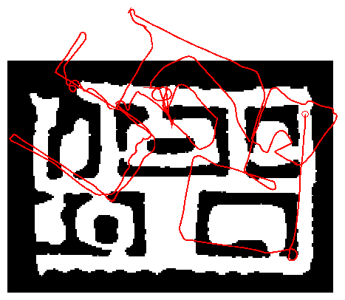
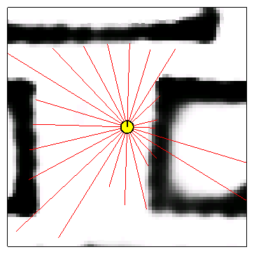
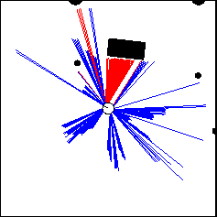
Nature of Sensor Data
Odometry Data
Range Data

Slide 44
Probabilistic Robotics
Address the fundamental problem of robotics i.e. how to combat uncertainty using the tools of probability theory
The need to model errors from sensors, actuators, and dynamic environment.

Slide 45
Recursive Bayesian Updating
state observations
Markov assumption: z_{n} is independent of z₁,...,z_{n-1} if we know x.

Slide 46
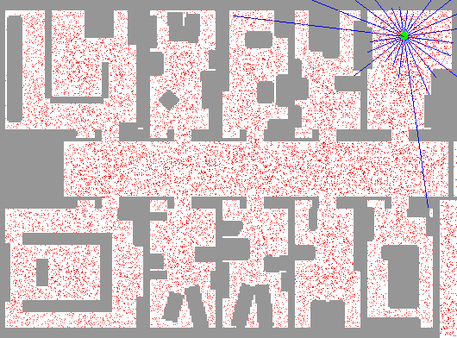
Localization

Slide 47
Navigation Challenges
Moving from place to place
Why is navigation hard?
Limitations and errors in sensing
Uncertainty in localization (where am I?)
Uncertainty in map or no map
Uncertainty in actuation

Slide 48
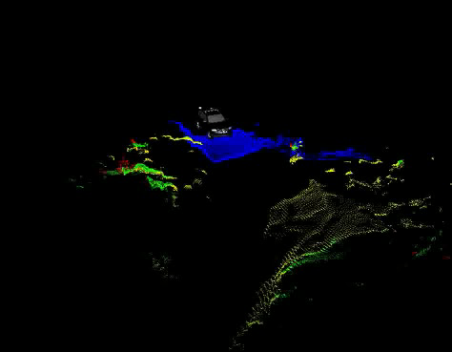

Slide 49
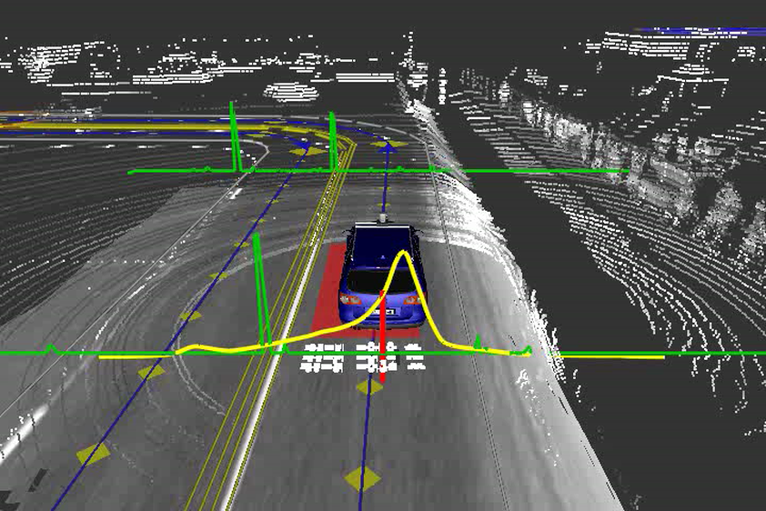

Slide 50
Navigation Involves
Localization
Path planning
Search / coverage
Mapping
Simultaneous Localization and Mapping (SLAM)

Slide 51
Localization
Have a map of the world, need to figure out where you are on the map.
Can use:
Global knowledge - GPS
Dead-reckoning - odometry
Landmark detection
Problems:
Estimation process is indirect
Measurements are noisy
Measurements are not always available

Slide 52
Landmark Detection
Compare view of world as perceived by sensors to stored world model - try to find a match
Examples:
Laser scans - scan matching
Vision - visual landmarks
Problems:
Output from sensors needs to match the format of the world model representation. (eg difficult to use vision to match to a sonar-built map)
Data association - may parts of the environment look the same
Environment changes - world model becomes outdated (e.g., change in lighting -> shadows change -> vision problems)

Slide 53
Path Planning
Finding a route from start to goal location
Need a map / world model
Need localization
World is often represented as a graph (topological map)
Use graph search techniques to find path (e.g., A*)
Problems:
Searching is slow
Dynamic environment -> world model outdated -> need to detect changes and re-plan new route.

Slide 54
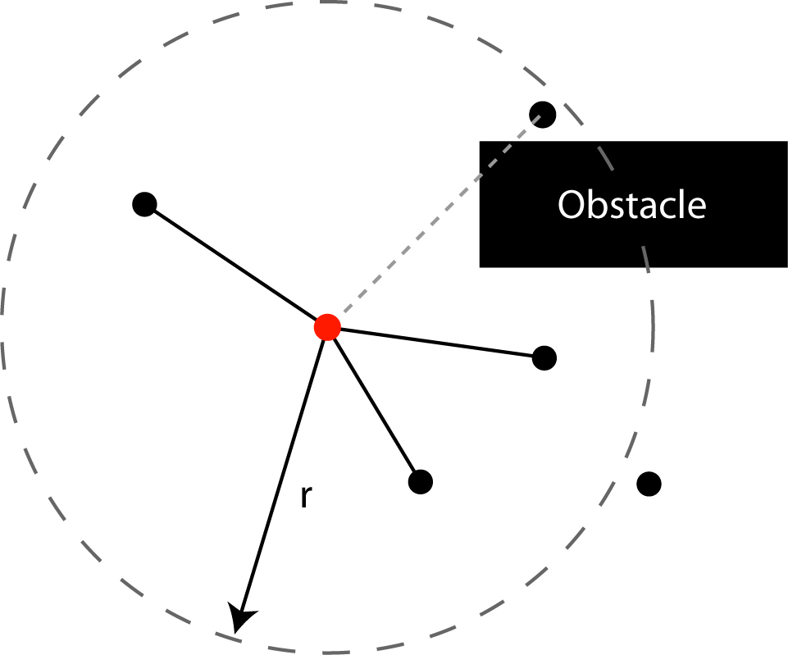
Planning Example - PRM
Probabilistic Roadmaps
Map Building Phase
Randomly add nodes to C_{free}
Attempt to connect to other nodes (local planner)
Query Phase
Connect start and goal to map
Use A* to find path from start to goal
Local Planner

Slide 55
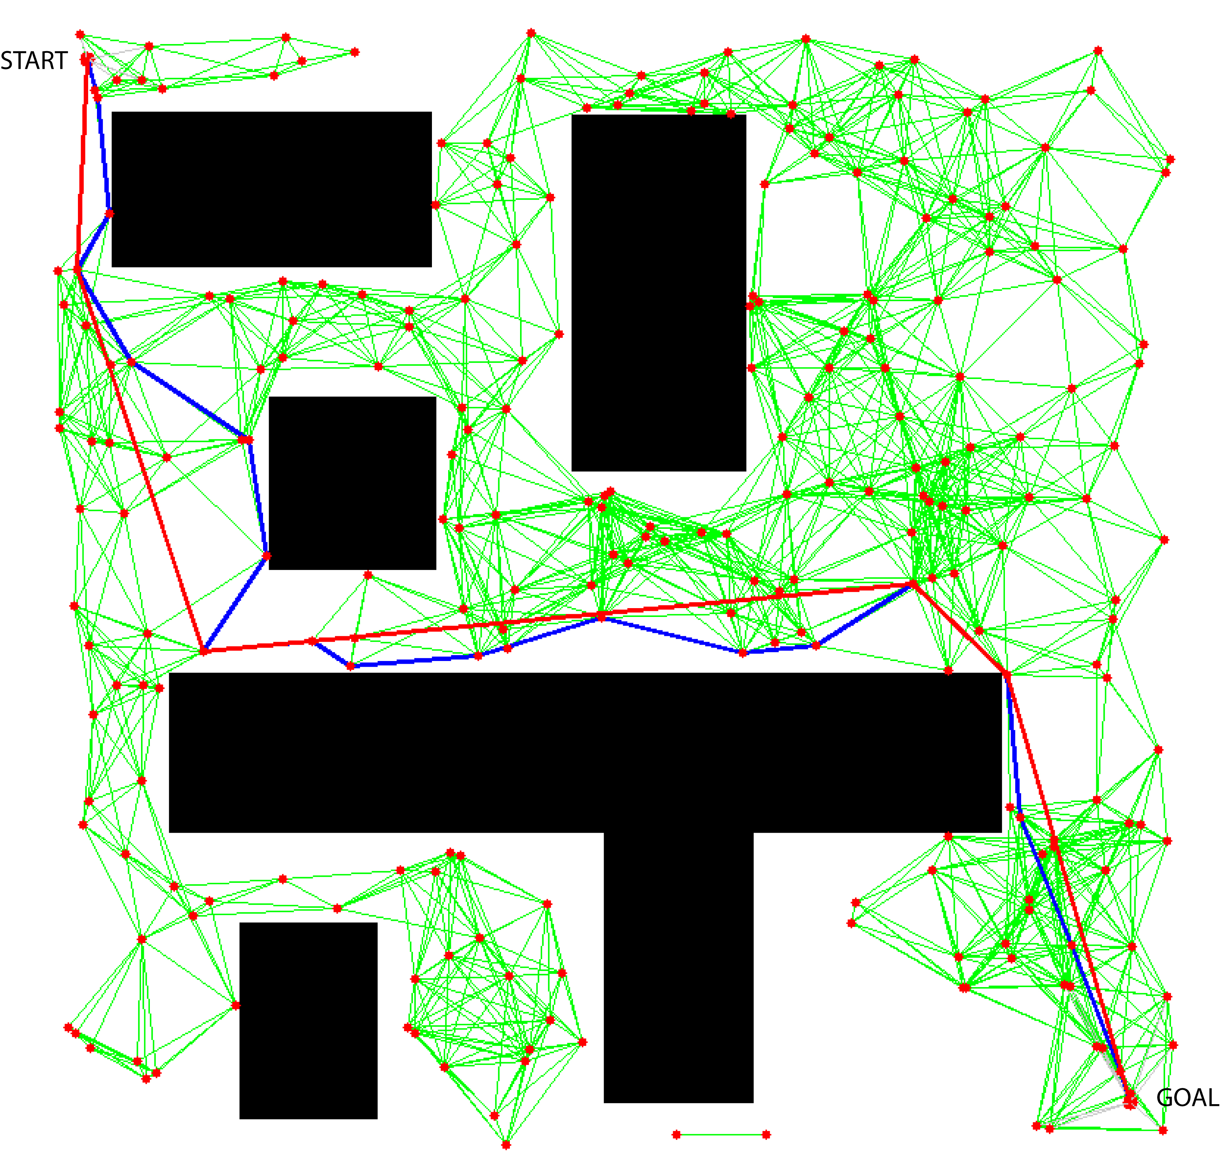
PRM Result
Original path
After path smoothing

Slide 56
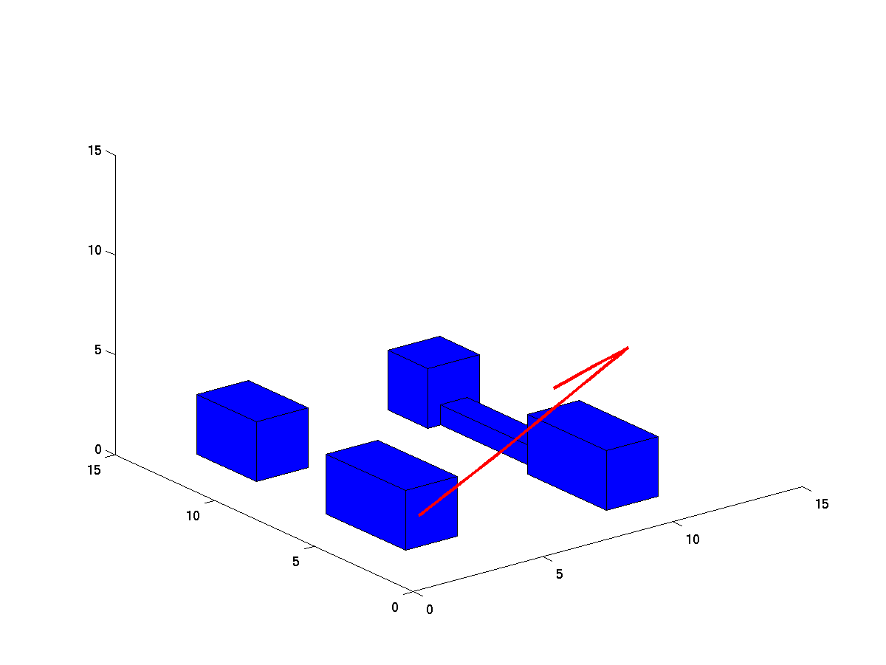
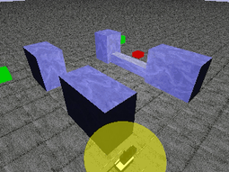
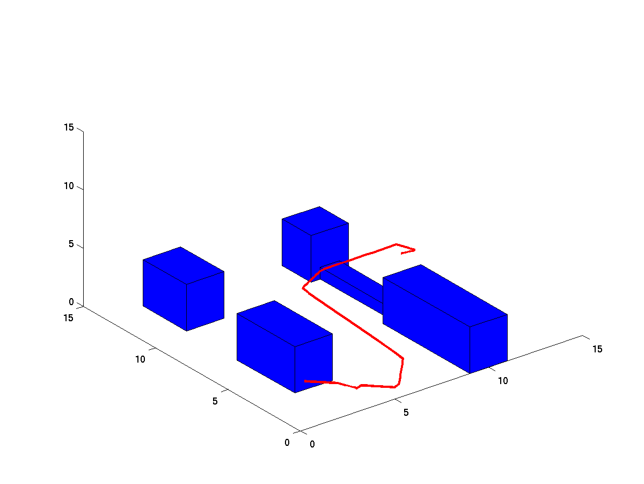
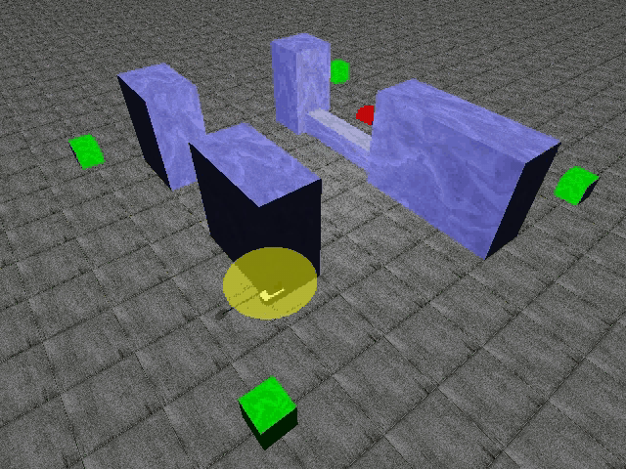
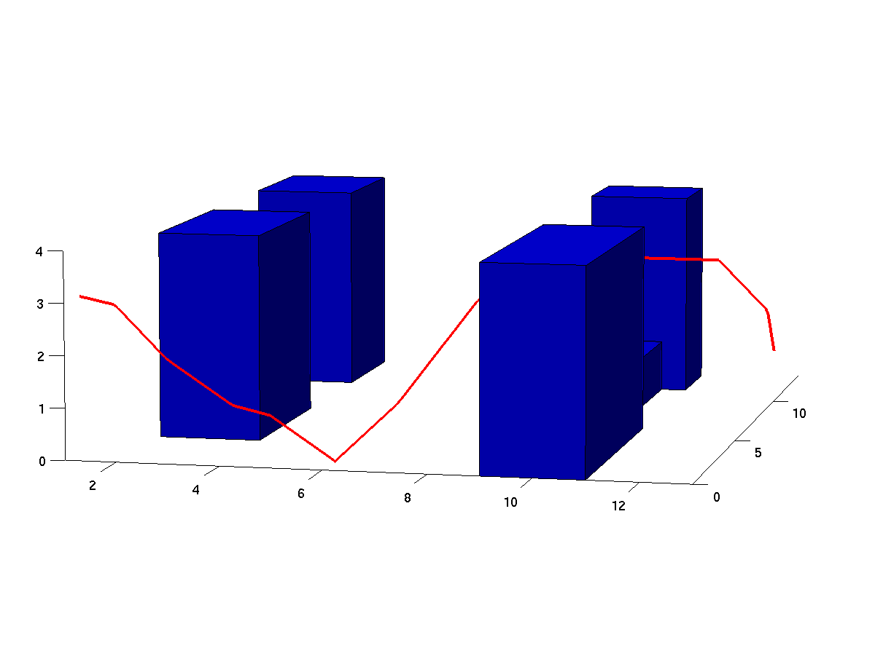
3D PRM results
No Height Constraint
4m Height Constraint

Slide 57
SLAM
SLAM: simultaneous localization and mapping
To start - no map and don’t know where you are
“Chicken and egg” problem: Need map to localize, but can’t build a map if you aren’t localized
Solution: Run mapping and localization in parallel - as map accuracy improves, localization improves, which improves the map, and so on

Slide 58
Coverage and Exploration
Try to explore an unknown area
Try to find something in an area
With map - can plan a path that covers the area
Without map - try to move in a systematic manner
Follow boundaries
Spiral outward
Random motion
E.g. - Roomba

Slide 59
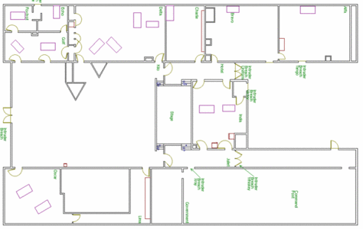
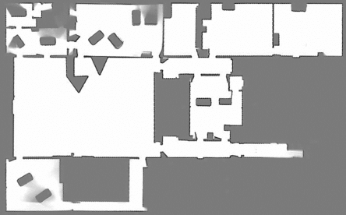
Example Exploration Results

Slide 60
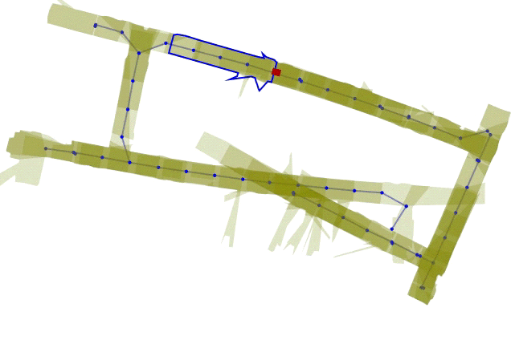
Common Navigation Challenges
Kidnapped Robot
Robot is localized, but is then moved (without being told)
Now it thinks it is still somewhere else - needs to re-localize
Closing the loop
When building a map, robot returns to the same place via another route - needs to realize this is the same place, and not a new area.

Slide 61
Monte Carlo Localization
the probability density function is represented by samples
randomly drawn from it
it is also able to represent multi-modal distributions, and thus localize the robot globally
considerably reduces the amount of memory required and can integrate measurements at a higher rate
state is not discretized and the method is more accurate than the grid-based methods
easy to implement

Slide 62
“Probabilistic Robotics”
- Sebastian Thrun
p( B | A ) • p( A )
Bayes’ rule
p( A | B ) =
p( B )
Definition of marginal probability
Σ
p( A ) = p( A ∧ B )
all B
Σ
p( A ) = p( A | B ) • p(B)
all B
Definition of conditional probability

Slide 63


Slide 64
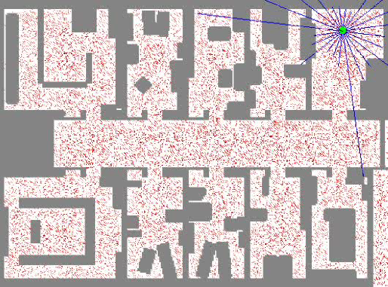
Monte-Carlo localization (Thrun)

Slide 65
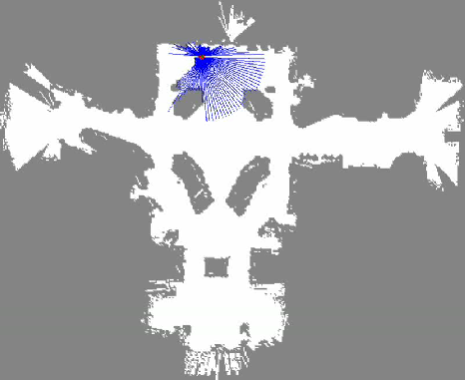
Monte-Carlo Localization

Slide 66

FASTslam (Thrun)

Slide 67

FASTslam

Slide 68
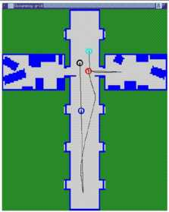
Setting up the problem
(following slides from Jizhong Xiao, CUNY)
The robot does (or can be modeled to) alternate between
sensing -- getting range observations o₁, o₂, o₃, …, o_{t-1}, o_{t}
acting -- driving around (or ferrying?) a₁, a₂, a₃, …, a_{t-1}

Slide 69
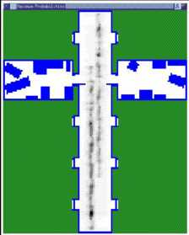
Setting up the problem
The robot does (or can be modeled to) alternate between
sensing -- getting range observations o₁, o₂, o₃, …, o_{t-1}, o_{t}
acting -- driving around (or ferrying?) a₁, a₂, a₃, …, a_{t-1}
We want to know r_{t} -- the position of the robot at time t
but we’ll settle for p(r_{t}) -- the probability distribution for r_{t}
!
What kind of thing is p(r_{t}) ?

Slide 70
Setting up the problem
The robot does (or can be modeled to) alternate between
sensing -- getting range observations o₁, o₂, o₃, …, o_{t-1}, o_{t}
acting -- driving around (or ferrying?) a₁, a₂, a₃, …, a_{t-1}
We want to know r_{t} -- the position of the robot at time t
but we’ll settle for p(r_{t}) -- the probability distribution for r_{t}
!
What kind of thing is p(r_{t}) ?
We do know m -- the map of the environment
p( o | r, m )
-- the sensor model
p( r_{new} | r_{old}, a, m )
-- the accuracy of desired action a

Slide 71
Robot modeling
map m and location r
p( o | r, m ) sensor model
p( | r, m ) = .75
p( | r, m ) = .05
potential observations o

Slide 72
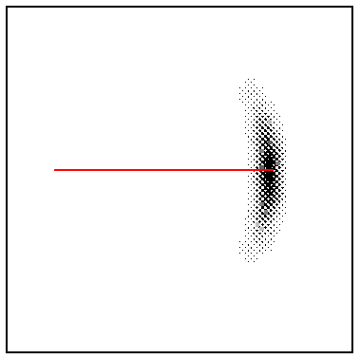
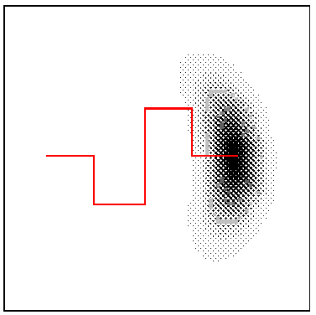
Robot modeling
map m and location r
p( o | r, m ) sensor model
p( r_{new} | r_{old}, a, m ) action model
p( | r, m ) = .75
p( | r, m ) = .05
potential observations o
“probabilistic kinematics” -- encoder uncertainty
red lines indicate commanded action
the cloud indicates the likelihood of various final states

Slide 73
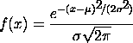
Robot modeling: how-to
p( o | r, m ) sensor model
p( r_{new} | r_{old}, a, m ) action model
(0) Model the physics of the sensor/actuators (with error estimates)
theoretical modeling
(1) Measure lots of sensing/action results and create a model from them
empirical modeling
take N measurements, find mean (m) and st. dev. (σ) and then use a Gaussian model
or, some other easily-manipulated model...
p( x ) =
0 if |x-m| > σ
p( x ) =
0 if |x-m| > σ
1 otherwise
1- |x-m|/σ otherwise
(2) Make something up...

Slide 74
Monte Carlo Localization
Start by assuming p( r₀ ) is the uniform distribution.
take K samples of r₀ and weight each with an importance factor of 1/K

Slide 75
Monte Carlo Localization
Start by assuming p( r₀ ) is the uniform distribution.
take K samples of r₀ and weight each with an importance factor of 1/K
Get the current sensor observation, o₁
For each sample point r₀ multiply the importance factor by p(o₁ | r₀, m)

Slide 76
Monte Carlo Localization
Start by assuming p( r₀ ) is the uniform distribution.
take K samples of r₀ and weight each with an importance factor of 1/K
Get the current sensor observation, o₁
For each sample point r₀ multiply the importance factor by p(o₁ | r₀, m)
Normalize (make sure the importance factors add to 1)
You now have an approximation of p(r₁ | o₁, …, m)
and the distribution is no longer uniform

Slide 77
Monte Carlo Localization
Start by assuming p( r₀ ) is the uniform distribution.
take K samples of r₀ and weight each with an importance factor of 1/K
Get the current sensor observation, o₁
For each sample point r₀ multiply the importance factor by p(o₁ | r₀, m)
Normalize (make sure the importance factors add to 1)
You now have an approximation of p(r₁ | o₁, …, m)
and the distribution is no longer uniform
Create r₁ samples by dividing up large clumps
each point spawns new ones in proportion to its importance factor

Slide 78
Monte Carlo Localization
Start by assuming p( r₀ ) is the uniform distribution.
take K samples of r₀ and weight each with an importance factor of 1/K
Get the current sensor observation, o₁
For each sample point r₀ multiply the importance factor by p(o₁ | r₀, m)
Normalize (make sure the importance factors add to 1)
You now have an approximation of p(r₁ | o₁, …, m)
and the distribution is no longer uniform
Create r₁ samples by dividing up large clumps
each point spawns new ones in proportion to its importance factor
The robot moves, a₁
For each sample r₁, move it according to the model p(r₂ | a₁, r₁, m)

Slide 79
Monte Carlo Localization
Start by assuming p( r₀ ) is the uniform distribution.
take K samples of r₀ and weight each with an importance factor of 1/K
Get the current sensor observation, o₁
For each sample point r₀ multiply the importance factor by p(o₁ | r₀, m)
Normalize (make sure the importance factors add to 1)
You now have an approximation of p(r₁ | o₁, …, m)
and the distribution is no longer uniform
Create r₁ samples by dividing up large clumps
each point spawns new ones in proportion to its importance factor
The robot moves, a₁
For each sample r₁, move it according to the model p(r₂ | a₁, r₁, m)

Slide 80
MCL in action
“Monte Carlo” Localization -- refers to the resampling of the distribution each time a new observation is integrated

Slide 81
References
Dieter Fox, Wolfram Burgard, Frank Dellaert, Sebastian Thrun, “Monte Carlo Localization: Efficient Position Estimation for Mobile Robots”, Proc. 16th National Conference on Artificial Intelligence, AAAI’99, July 1999
Dieter Fox, Wolfram Burgard, Sebastian Thrun, “Markov Localization for Mobile Robots in Dynamic Environments”, J. of Artificial Intelligence Research 11 (1999) 391-427
Sebastian Thrun, “Probabilistic Algorithms in Robotics”, Technical Report CMU-CS-00-126, School of Computer Science, Carnegie Mellon University, Pittsburgh, USA, 2000

